Slide 1
WELCOME TO FA3 ASSESS
27 / 05 / 2025
Presented by
ELIPHAS PHALAKATSHELA
Software Development
Facilitator

Slide 2
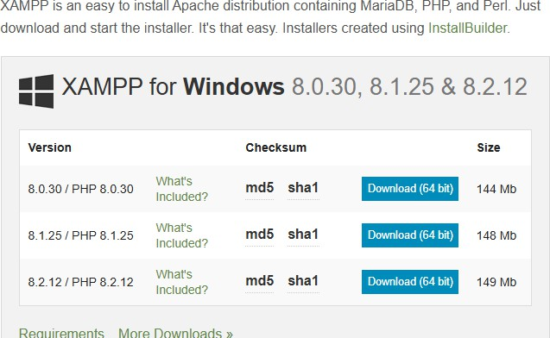
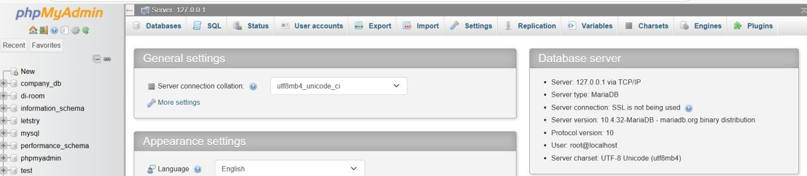
STEP 1 Installing the PHP
1. Search XAMMP Download https://www.apachefriends.org/download.html
2. Navigating Through the XAMMP
3. Navigating the XAMMP in VS Code

Slide 3
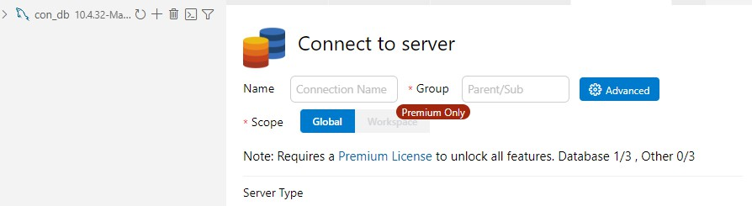
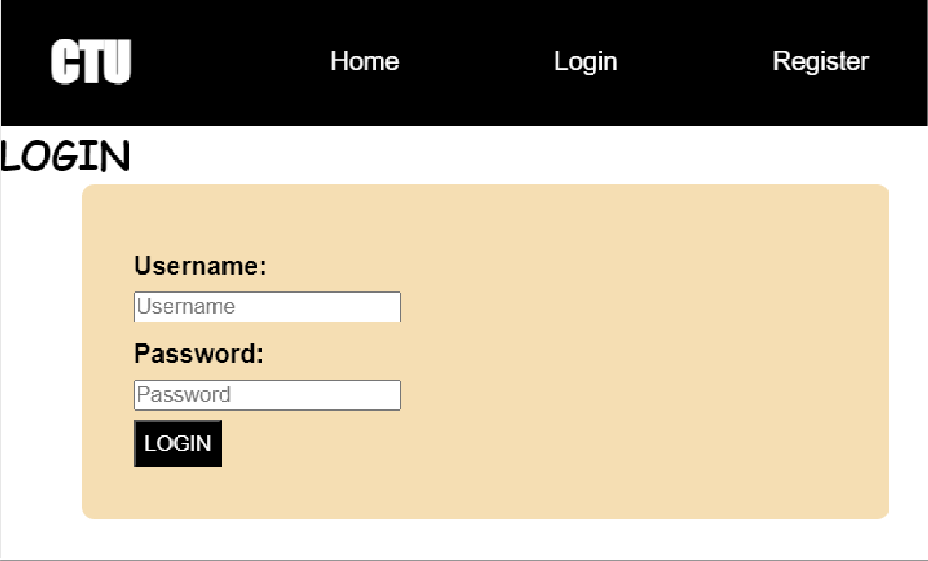
4. Creating The forms in VS-Code to be able to create the tables

Slide 4
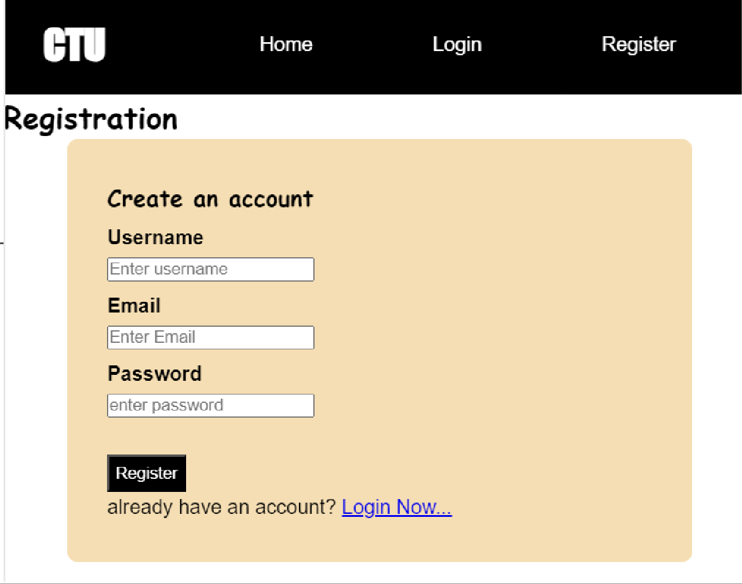
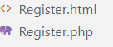
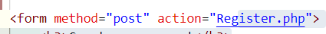
5. Creating Tables in XAMPP Activities
- Creating a tables called Registration, Plots, Messages based on The form inputs
6. Adding the PHP and Linking the PHP files with .Html files for forms
7. Hosting the website with Netlify Log in | Netlify

Slide 5
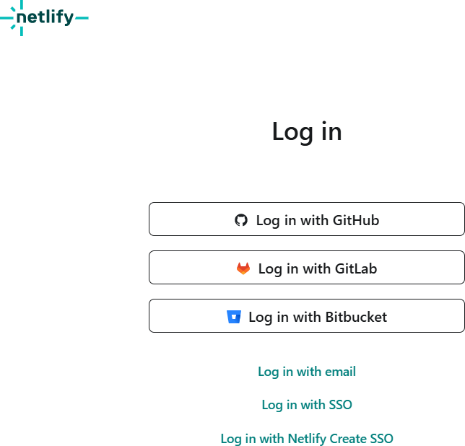
- After Login Click on Add new Project then Deploy Manually then you will see the window as below

Slide 6

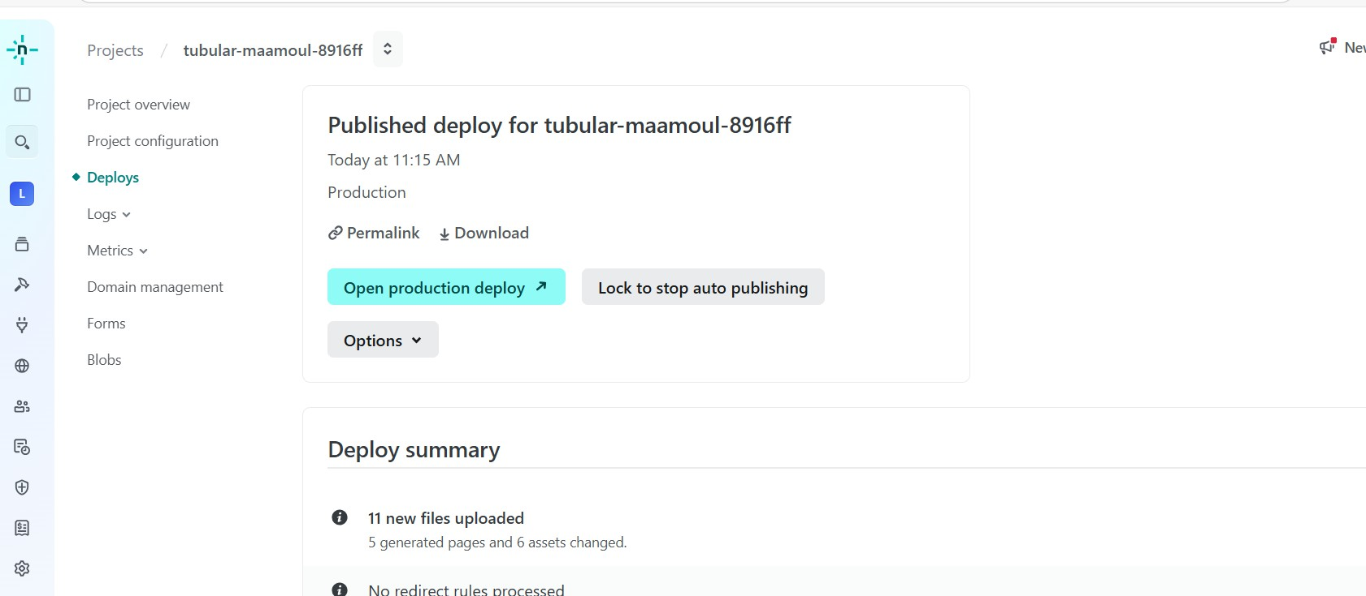
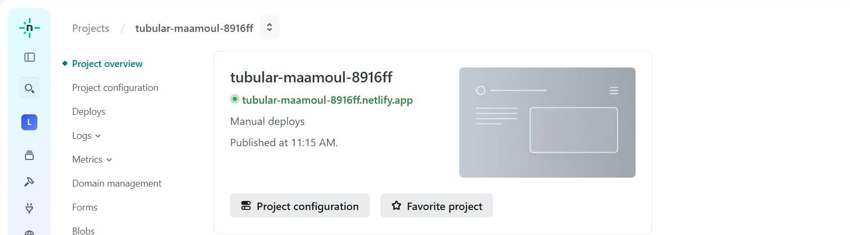
It being successful you will see the below will all the files making you project at the end.

Slide 7
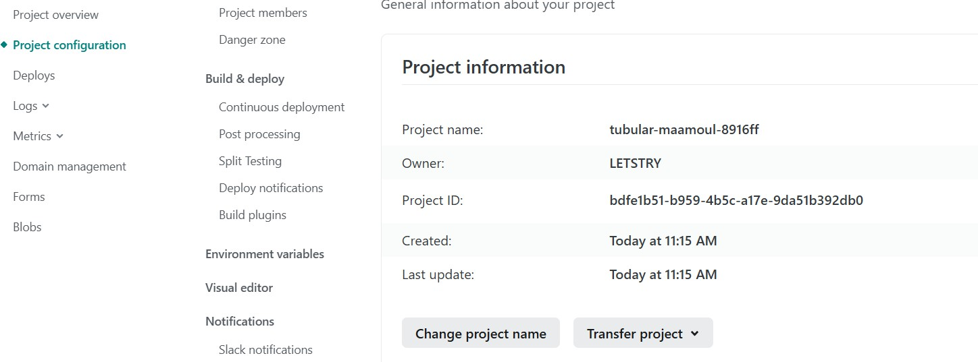
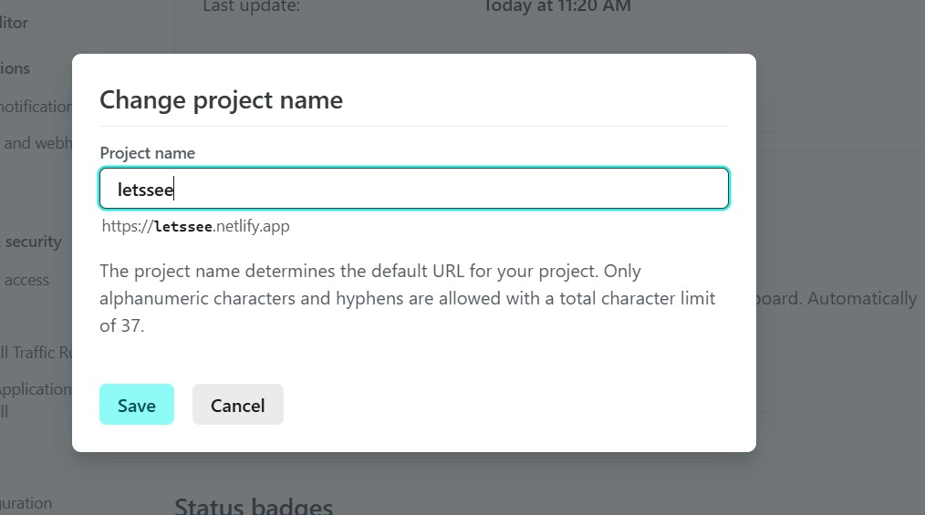
Click on the tabular --- That will be name of your website
Or click on Project configuration to rename it to your own name e.g Letsee name below
-
-
http://localhost/Ticket%20Hub/Register.html
Document

Slide 8
THANK YOU …

